Slide 1
Unit 5
Why do you like pandas?
Section B 3a-Self Check
七年级(下)

Slide 2
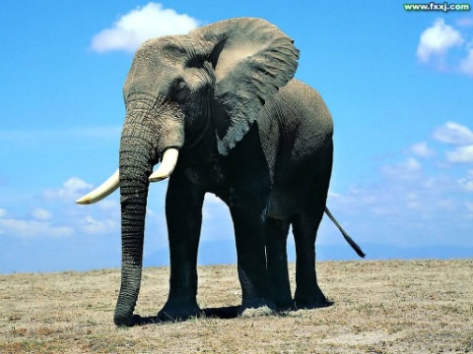
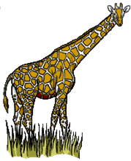
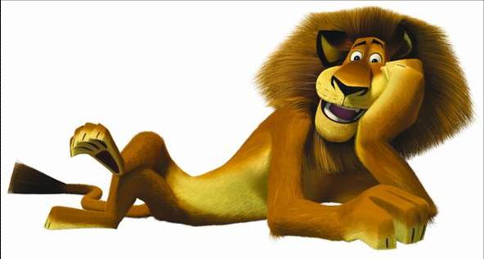
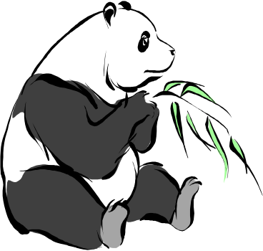
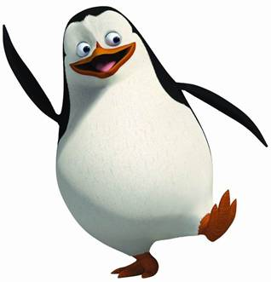

name
others
age
A description of an animal
where to live
nationality
appearance
what to eat
personality
hobby

Slide 3




Discuss
1. What animals can swim?
2. What animals eat grass?
3. What animals eat meat?
4. What animals eat leaves?
leaf -- leaves

Slide 4
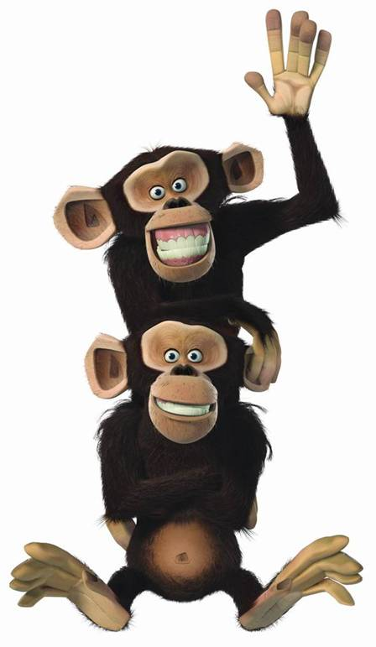
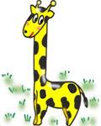
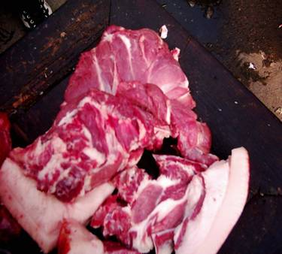
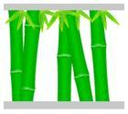





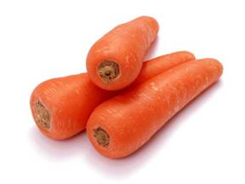
What food do they like eating?
They like eating…

Slide 5
What food do they like?
Pandas like bamboos.
Koalas like leaves(树叶)．
Tigers like meat.
Elephants like grass.
Lions like meat.
Giraffes like leaves.
Penguins like seafood.
Dolphins like fish.

Slide 6
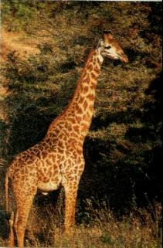
3a. Becky is Jill’s favorite animal. Fill
in the blanks with the words in the box.
like beautiful Africa years lives because
This
beautiful
is Becky. Isn’t she _________?
She is from ______. She is twelve
______old. I ______ Becky ______
she is smart and friendly. She ______
in Blackwood Zoo.
Africa
years
like
because
lives

Slide 7
3b. Write a description of a panda using
the words in the box, or write about
Your favorite animal using your own
ideas..
Beibei five years old China cute shy Beijing Zoo
My favourite animal is a panda in
the Beijing Zoo. I call her Beibei.
She is black and white. She is very
big but she looks kind of cute .…

Slide 8

1. 这是一篇介绍动物的短文，主要应用系表结构的句子来表达，用一般现在时态。
2. 先介绍Beibei的名字及年龄。然后介绍它来自哪里。
3. 再用系表结构的句子描写Beibei的特征。同时写明喜欢它的原因。可以用句子结构：I like … because she’s …
最后，写明它现在居住在哪里，并通读
一遍短文，看有没有写错的句子。

Slide 9

This is Beibei. She’s from China. She is five years old. She is black and white. Isn’t she cute? I like Beibei very much because she’s kind of shy. She lives in Beijing Zoo.

Slide 10
Sample writing:
My favorite animal is a tiger in the city zoo. I call him Super T. He is orange, black and white. He is very big, and he looks kind of scary. He can run fast and jump far. People and other animals are afraid of him. He sleeps in the daytime and walks around at night. I go to see him every weekend, and I have a photo of him on my bedroom wall.

Slide 11

1 Add more words in the chart. Then write at least five sentences using the words.
Animals | Description words
tiger | really, kind of | scary
giraffe
very beautiful
panda
kind of cute
dog
really friendly
lion
kind of scary
elephant
really smart

Slide 12

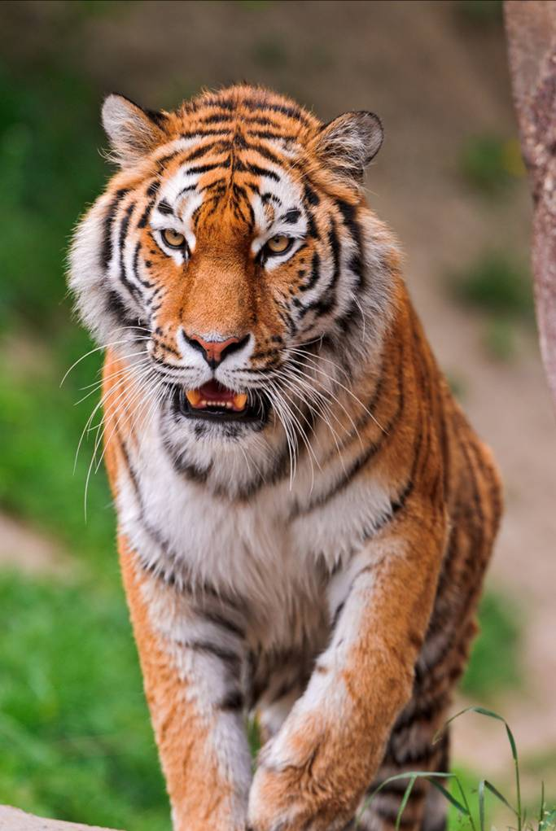
I don’t like tigers because they’re really scary.

Slide 13

1. ___________________________________
2. ___________________________________
3. ___________________________________
I like giraffes because they’re beautiful.
I like pandas because they’re kind of cute.
I like dogs because they’re very friendly.

Slide 14
4.______________________________________________________________________
5.______________________________________________________________________
I don’t like lions because they’re really
scary.
I like elephants because they’re really
smart.

Slide 15
2.Match the questions and answers to make a conversation. Then write your own conversations.
Questions | Answers
What animals do you like? | They’re from Africa.
Why do you like lions? | I like lions.
Where are they from? | Because they’re big and beautiful.

Slide 16

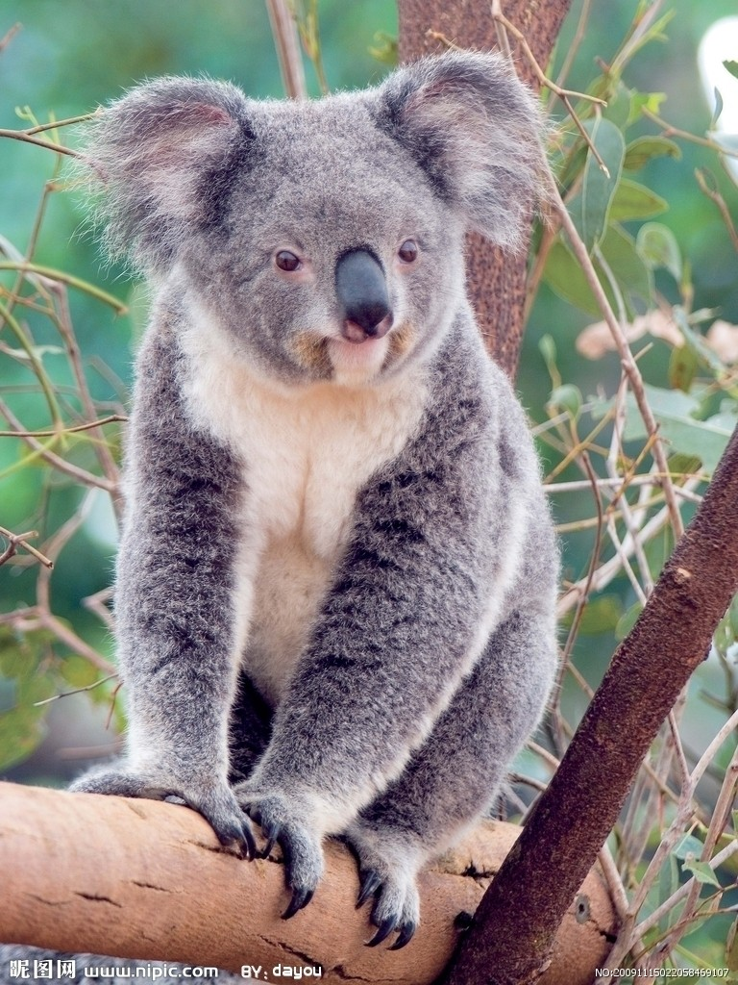
Look at the picture and fill in the blanks.
A: What’s your favorite _______?
B: My favorite animal is ______.
A: _____ do you like _____?
B: Because _____ are funny.
A: _________ they _____?
Are they from Canada?
B: No, they ______. They’re ____
________.
animal
koalas
Why them
they
Where’re from
aren’t
from
Australia

Slide 17

用所给的词组或单词造句。
Lions are from Africa.
be from ________________________
kind of __________________________
like … because…
___________________________________
Pandas are kind of shy.
My sister likes cats because they’re cute.

Slide 18
4. don’t like … because …
_________________________________ _________________________________
5. get lost _________________________________
6. in danger _________________________________
7. cut down _________________________________
They don’t like elephants because they’re lazy.
We sometimes get lost in a big city.
Is that elephant in danger?
You can’t cut down these trees.

Slide 19
选择填空。
A
1. _____ pandas from China?
A. Are B. Is C. Do
2.--Why do you like koala bears?
--_____ they are cute and smart.
A. And B. For C. Because
3. ______ is the biggest animal on the earth.
A. The elephant B. The koala bear
C. The giraffe
C
A

Slide 20
B
4. Students ______ nine hours a day.
A. sleeps B. sleep C. are sleep
5. People usually think lions are _____ scary.
A. kinds of B. kind C. kind of
6.--Which kind of animals have long legs
and neck?
--_______.
A. Pandas B. Penguins C. Giraffes
C
C

Slide 21
C
7. Tigers like _____ meat.
A. eat B. eats C. eating
8. Koala bears sleep _____.
A. at night B. during the day
C. at noon
9. Do you ever play _____ pandas?
A. with B. to C. and
10. Foxes can count numbers. So people think they are _____.
A. scary B. interesting C. clever
B
A
C

Slide 22
favorite do are does animals let let’s come
Fill in the blanks.
animals
1. -- What kind of ________ do you think
are the biggest on the earth?
-- Elephants.

Slide 23
2. Why ______ Maria like small animals?
3. Is your ________ pet panda?
4. Where do lions ______ from?
5. ______ go to see the new teacher in our
school.
does
favorite
come
Let’s

Slide 24
句型转换。
1. I want to see the lions.（对划线部分提问）
_____ _____ you want _____ _____？
What do
to do
解析: want to do sth. 表示“想要干某事”。

Slide 25
2. Can you tell me how I can get to the
airport？(同义句转换)
Can you tell me _____ _____ _____ the
airport?
the way to
解析: the way to表示“去……的路”，
这是复合句与简单句的转换。

Slide 26
3. Mary wants to go to the zoo with her
friends. (同义句转换)
Mary _______ _____ to go to the zoo
with her friends.
would like
解析: want to do sth.其同义词为would
like to do sth. “想要干某事”; want有人
称和数的变化, 而would则没有。

Slide 27
4. His brother likes dolphins. (对划线部分
提问)
______ _______ ______his brother _____?
What animals does
like
解析: 对动物提问用What animals或
What animal, 句中dolphins为复数形式，
因此用What animals。

Slide 28
5. Let’s see the pandas first. (同义句转换)
______ _______ seeing the pandas first？
What about
解析: Let’s...是表示建议的句型, 此句型还有
What/How about doing sth?
Shall we do sth?
Would you like to do sth?

Slide 29

Make a survey in your family. See what animals do they like and why?
Make a list of the animals that you know.

Slide 30
Thank You!

